Slide 1
Ultimate Tic Tac Toe
Jeremy Falloon - Stephanie Parkhurst
Shannon Marshall - Sang Bui

Slide 2
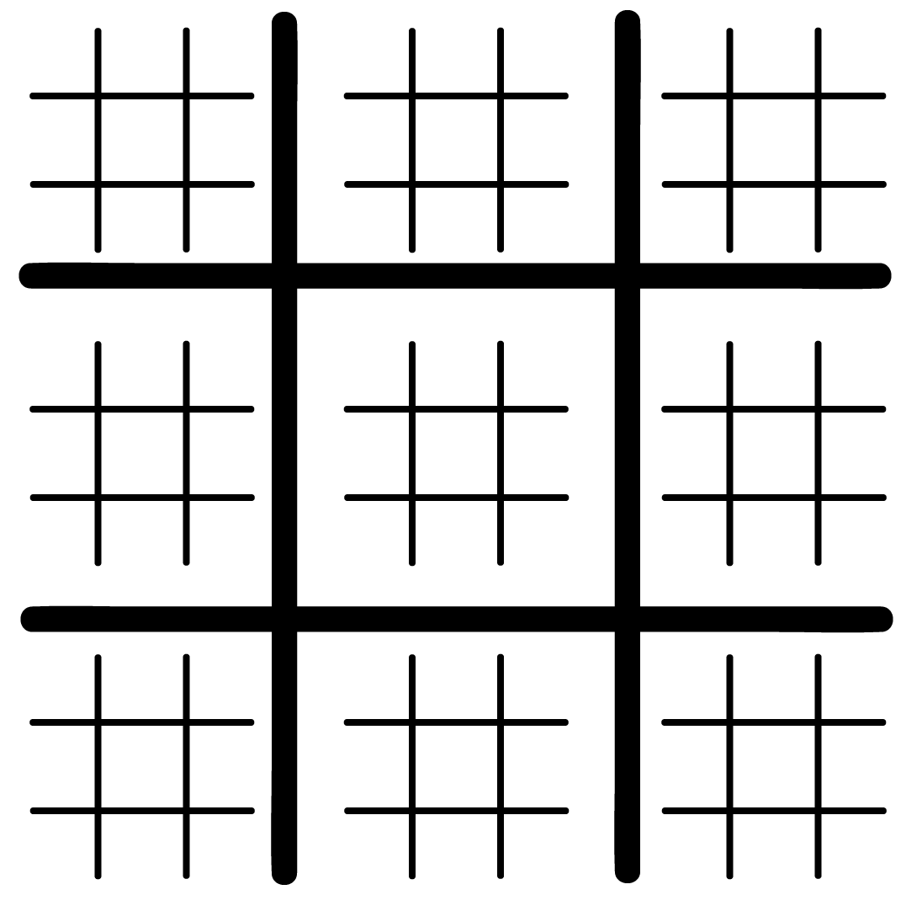
Game Rules

Slide 3
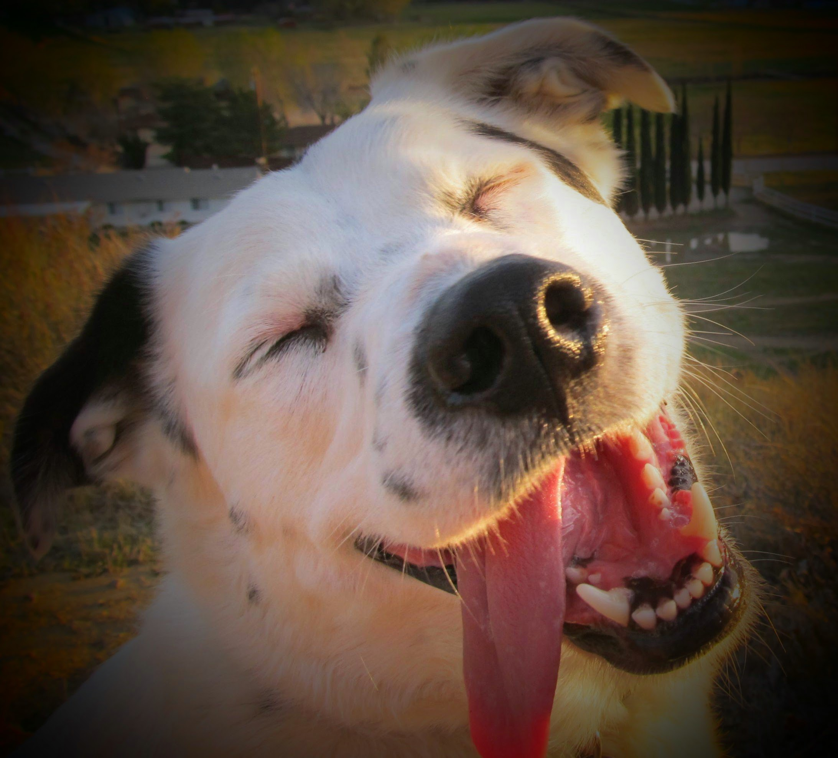
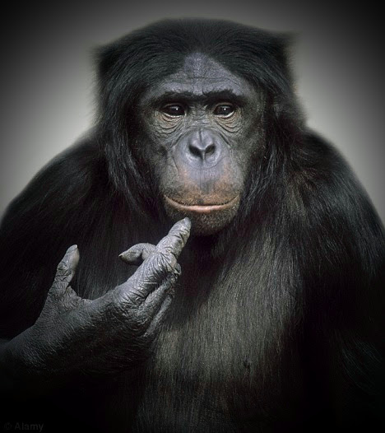
Our Projects
Easy Bot
Plays randomly
Medium Bot
Blocks any opponent’s winning moves
If corners are available, play in the corners
Randomly
I can go anywhere I want
Huh! I see what you are doing...

Slide 4
AI Heuristics
Alpha-beta minimax search
Iterate through each block of game board
Count the number of opponent’s pieces per block
Find the min in each block and invert the value
Maximize our moves by sending them to the block with the least amount of opponent’s pieces

Slide 5
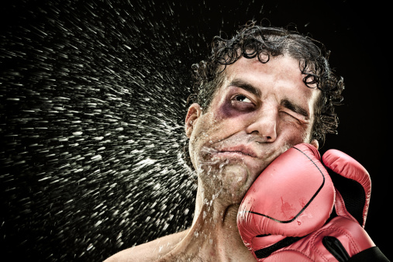
Who’s Smarter
AI vs. Easy Bot: AI won 95%
AI vs. Medium Bot: AI won 75%
Easy vs. Medium Bot: Medium Bot won 55%
Jeremy vs. Shannon: they both suck, period

Slide 6
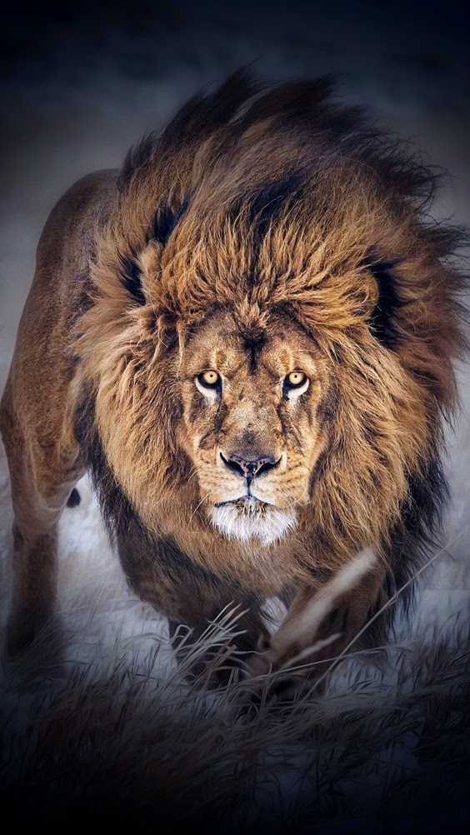
Are You Ready
To
Challenge Me

Slide 7
The End
Thank You

